Slide 1
Time Series Analysis

Slide 2
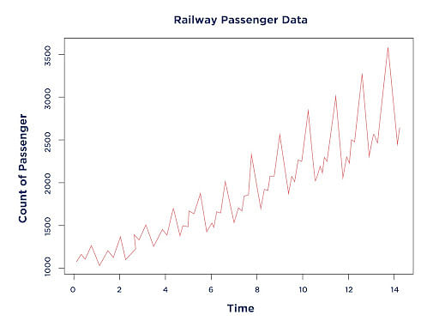
What is a Time Series?
Time series: Data arranged in the chronological order of time
Example: Profits of a company over the last few years, Price of Indian Rupee versus Euro over the last decade, Number of monthly railway passengers from 1960 to 1980

Slide 3
Pandas and Time Series
DateTime Index
Time Resampling
Time Shifting
Rolling and Expanding
Time Series Visualization

Slide 4
DateTime Index: Creating a datetime Object
C:\code\Data Analytics\implementation\time_series\time-series-basics\1_create_date_time_object.py

Slide 5
DateTime Index: NumPy
C:\code\Data Analytics\implementation\time_series\time-series-basics\2_datetime_index_numpy.py

Slide 6
DateTime: Pandas
C:\code\Data Analytics\implementation\time_series\time-series-basics\3_datetime_pandas.py

Slide 7
Time Resampling
import pandas as pd
C:\code\Data Analytics\implementation\time_series\time-series-basics\4_time_resampling.py

Slide 8
Time Shifting
C:\code\Data Analytics\implementation\time_series\time-series-basics\5_time_shifting.py

Slide 9
Rolling and Expanding
C:\code\Data Analytics\implementation\time_series\time-series-basics\6_rolling_and_expanding.py

Slide 10
Visualizing Time Series
C:\code\Data Analytics\implementation\time_series\time-series-basics\7_visualize_time_series.py

Slide 11
The statsmodels Library
Provides classes and functions for estimation of various statistical models
Also useful in statistical tests and statistical data exploration

Slide 12
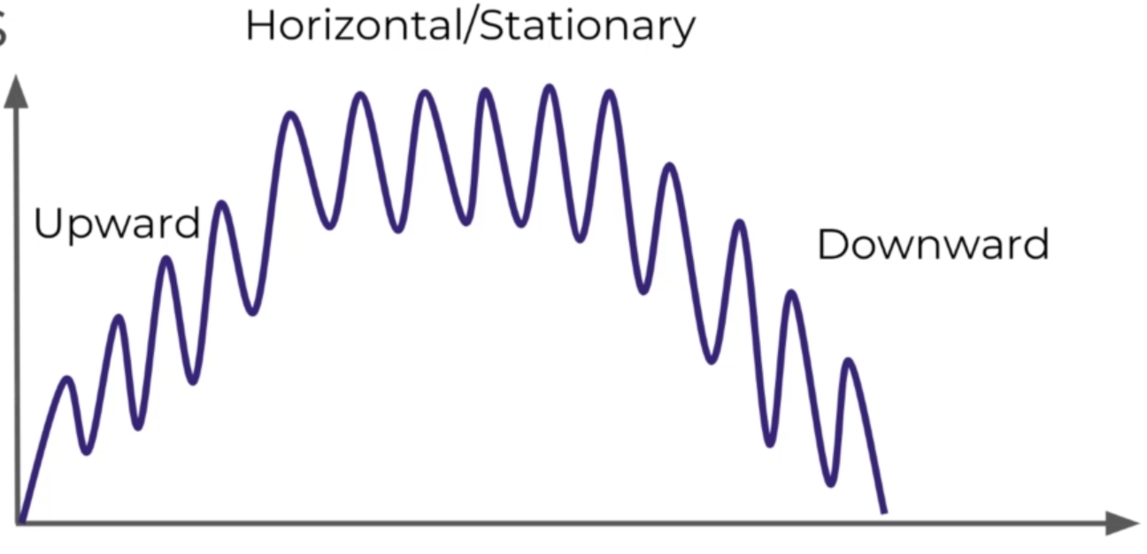
Time Series Trends

Slide 13
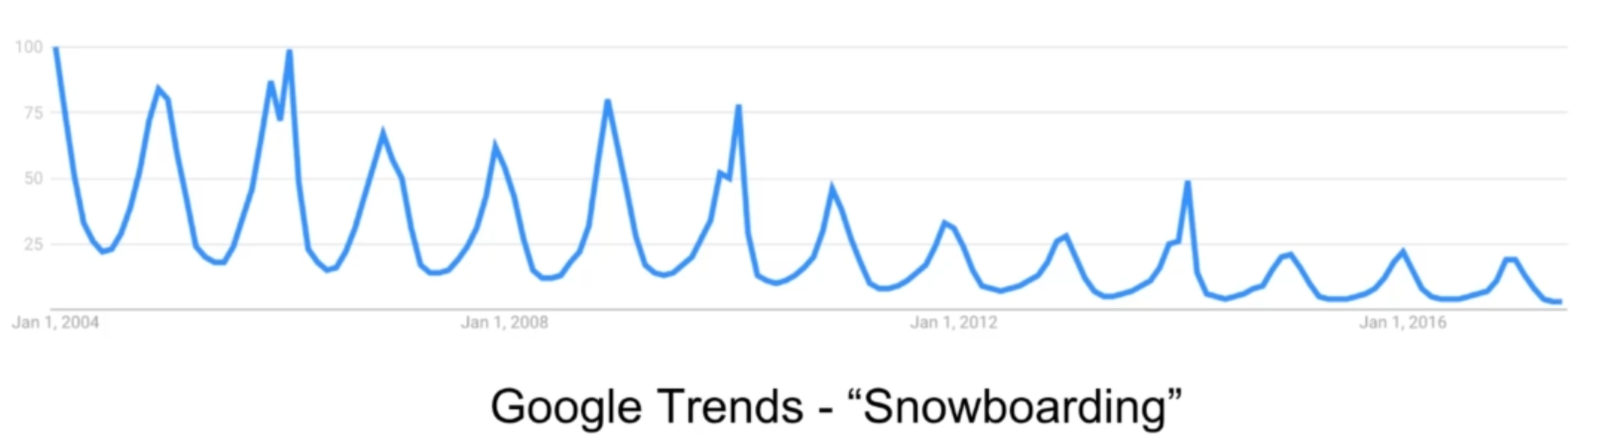
Time Series Seasonality – Repeating Trends

Slide 14
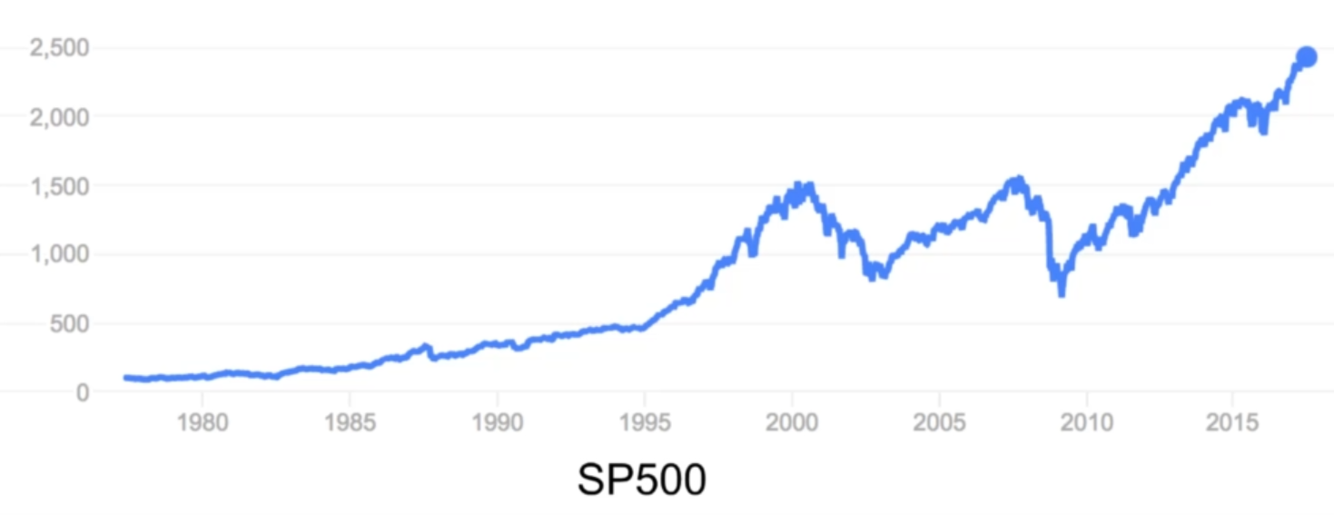
Time Series Cyclical Component – Trends with No Set Repetition

Slide 15
Time Series Forecasting
A time series is called stationary if it does not show trends or seasonality
That is, fluctuations in data are entirely due to outside factors and noise
Non-stationary data can be made to look like stationary data using the technique of differencing

Slide 16
ACF and PACF
Auto Correlation Function (ACF) and Partial Auto Correlation Function (PACF) are based on the idea of correlation
Correlation: Linear relationship between two variables
(a) The closer the correlation to +1, stronger is the relationship
(b) The closer to -1, stronger is the negative (opposite) relationship
(c) The closer to 0, weaker is the relationship
Autocorrelation: Correlation of a time series with itself, lagged by x time units: y-axis: Correlation, x-axis: Number of time units of lag
Example: Sales data shifted by one time step: How are today’s sales correlated to yesterday’s sales?

Slide 17
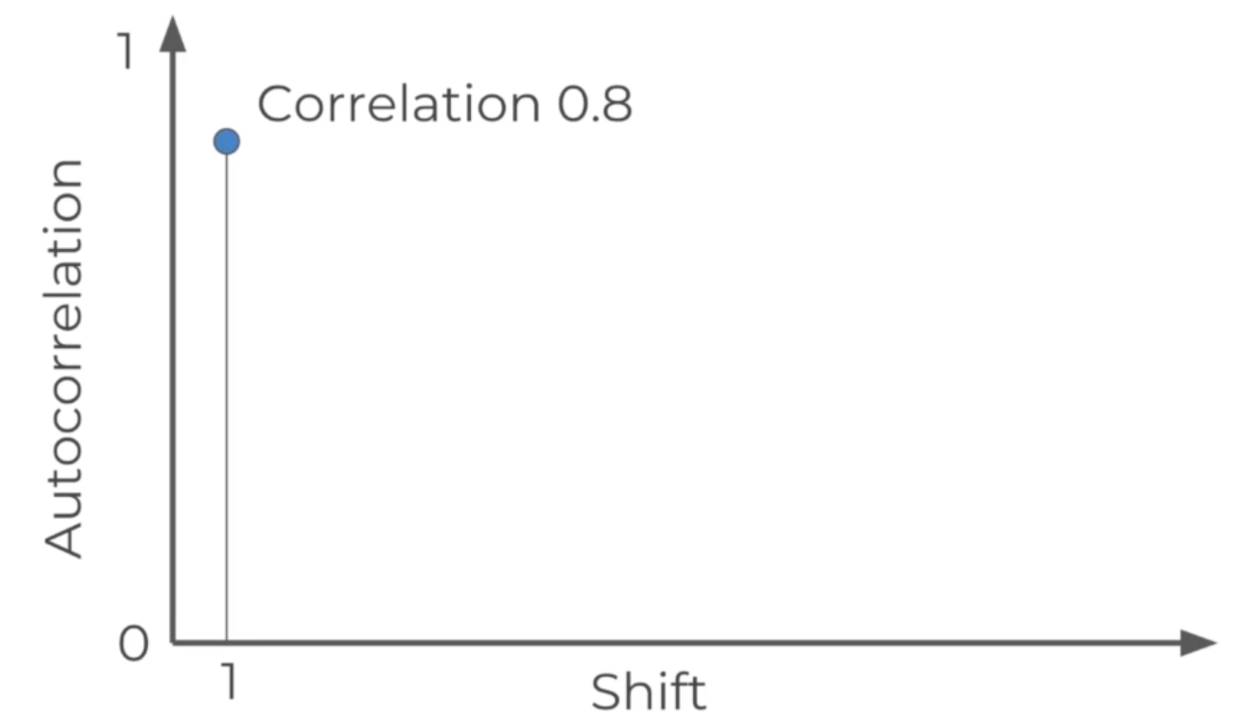
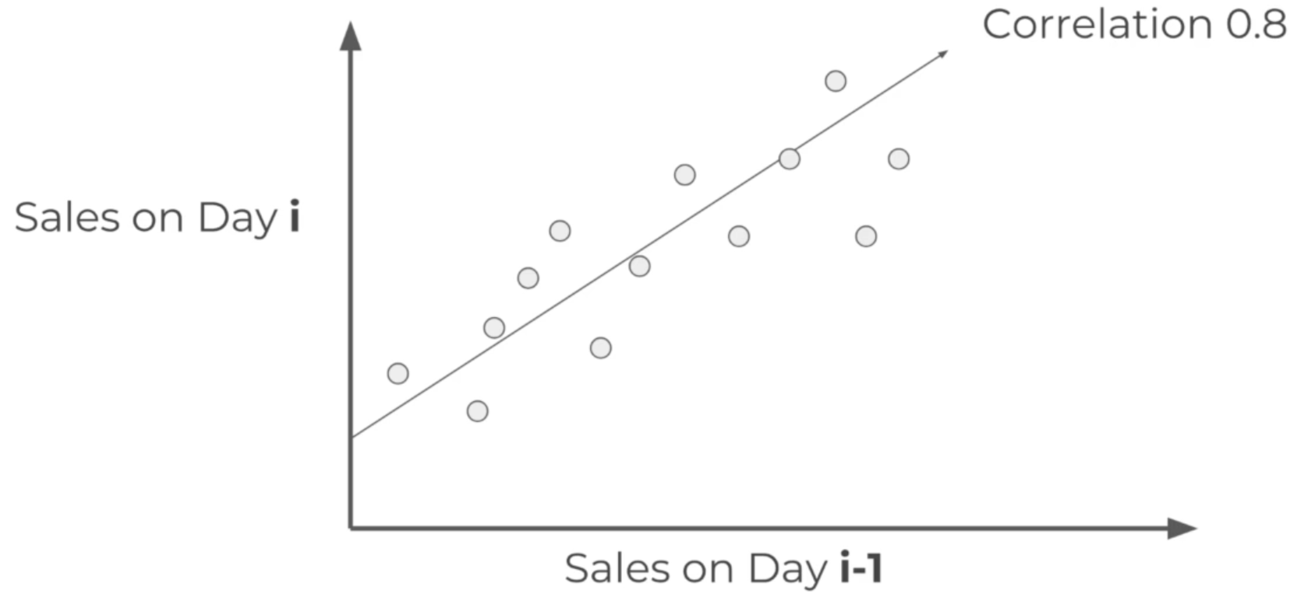
Autocorrelation Concept
Sales on Day i and i-1
ACF graph

Slide 18
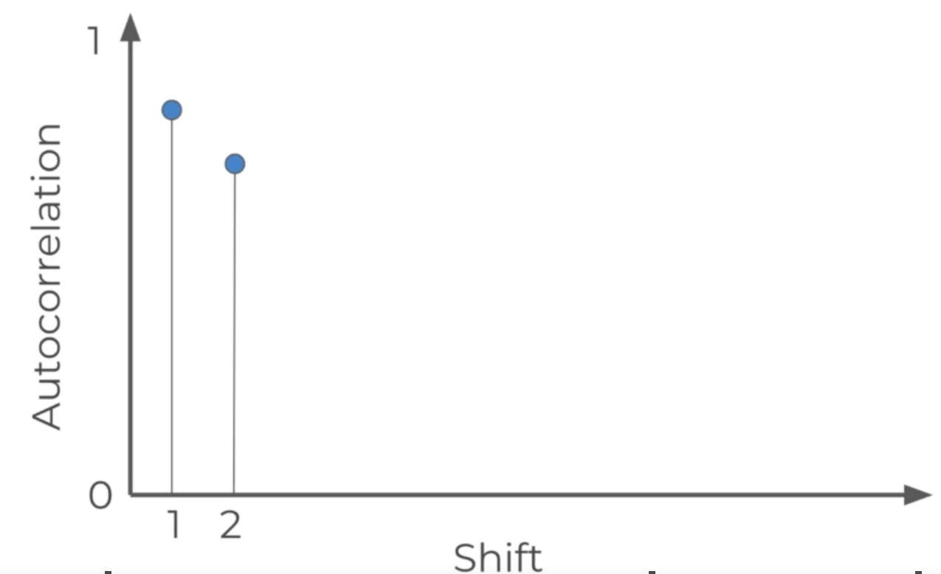
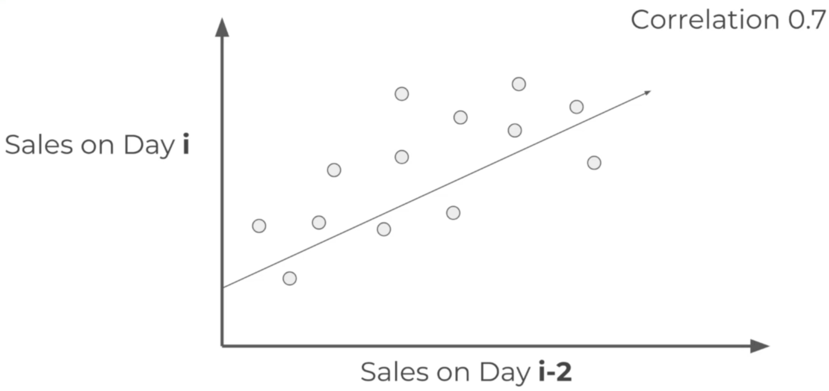
Autocorrelation Concept
Sales on Day i and i-2
ACF graph

Slide 19
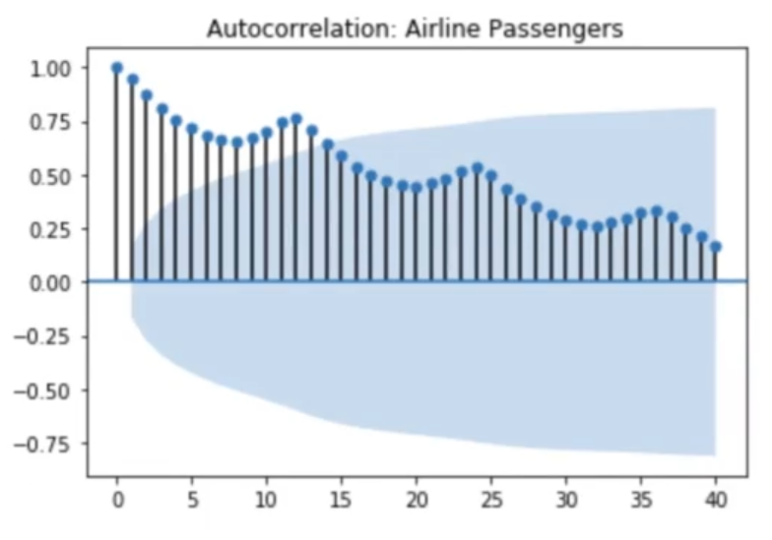
Autocorrelation Example: Gradual Decline

Slide 20
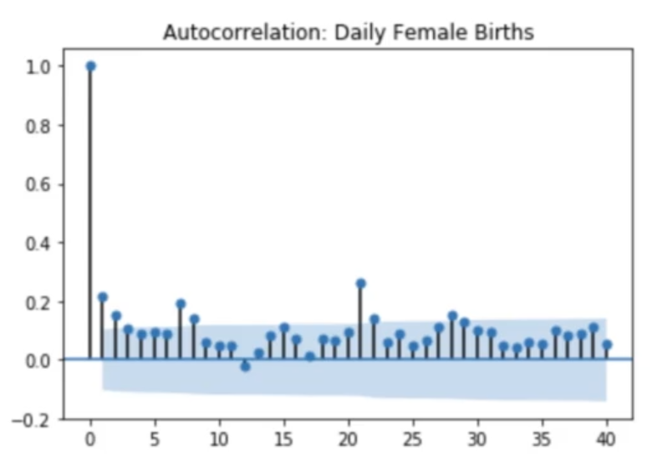
Autocorrelation Example: Sharp Drop-off

Slide 21
Autocorrelation General Principle
The further we move away from the beginning, there is some sort of decline, either gradual or sharp

Slide 22
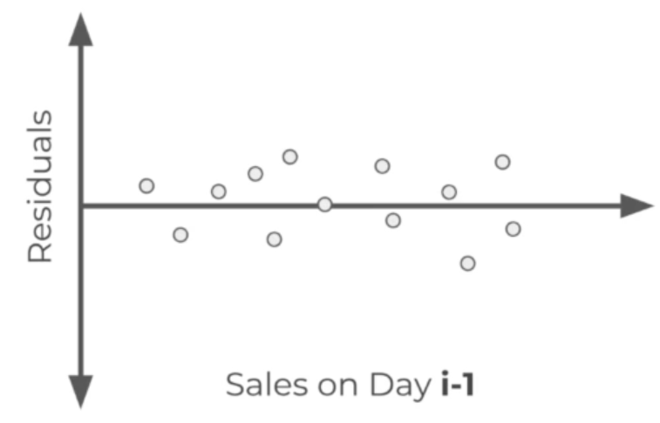
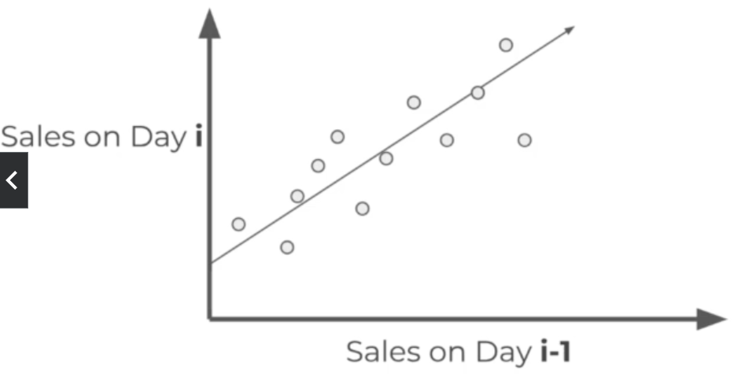
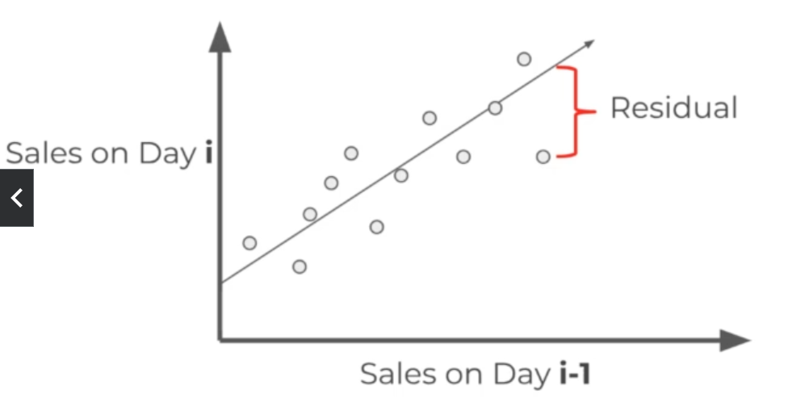
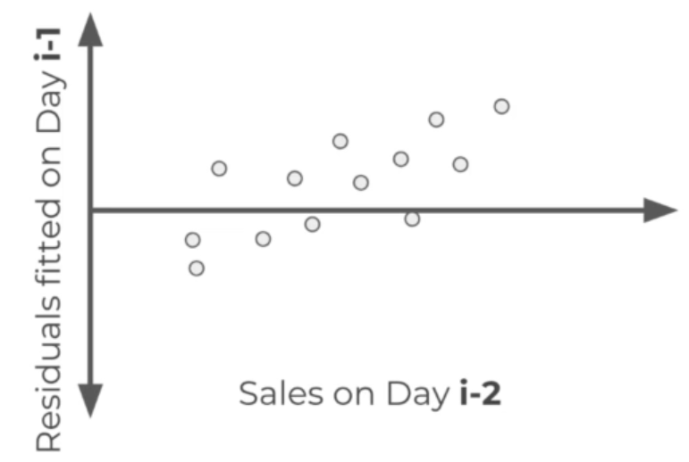
Partial Autocorrelation
Here, we measure the residuals or errors (difference between actual values and that estimated by the line of regression)
Similarly, for day 2, etc …

Slide 23
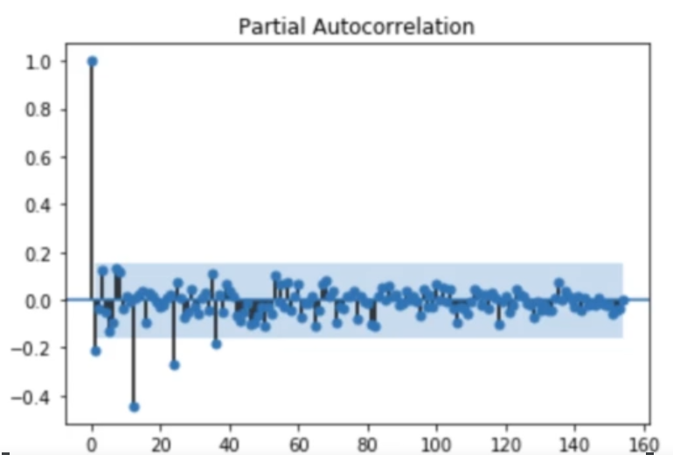
Partial Autocorrelation Example
Plot of the relationship between the previous day’s residuals versus the real values of the current day

Slide 24
ACF and PACF Summary
ACF: Autocorrelation between an observation and another past observation (lag) that includes the direct and indirect dependence
PACF: Direct relationship between an observation and its lag
C:\code\Data Analytics\implementation\time_series\time-series-basics\9_acf_pacf_start.py

Slide 25
ARIMA
AutoRegressive Integrated Moving Average (ARIMA) is used for making time series prediction
Note: It may not be appropriate in some cases (e.g. Future stock price prediction) when the data is not directly a function of time
ARIMA works well when data is directly related to timestamp, e.g. airlines passenger data
ARIMA is a generalization of the AutoRegressive Moving Average (ARMA) model

Slide 26
ARIMA
A non-seasonal ARIMA model is generally of the form: ARIMA(p,d,q)
Where
Auto regression (p): A regression model that utilizes the dependent relationship between a current observation and observations over a past period
Integrated (d): Value of diff used to make time series stationary
Moving Average (q): Plot the moving average and find the residual error

Slide 27
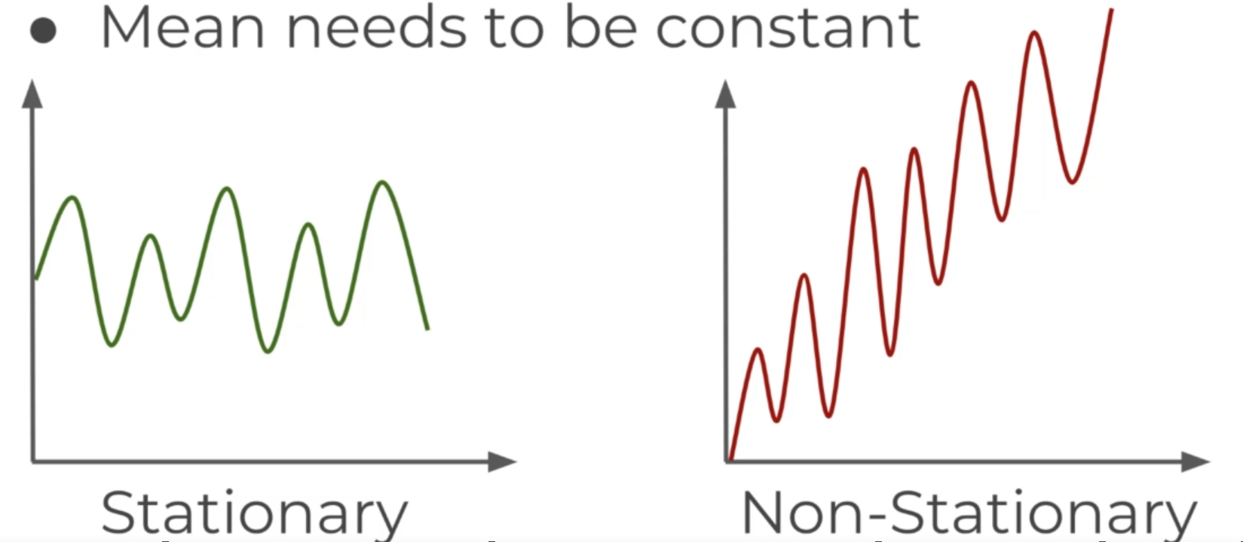
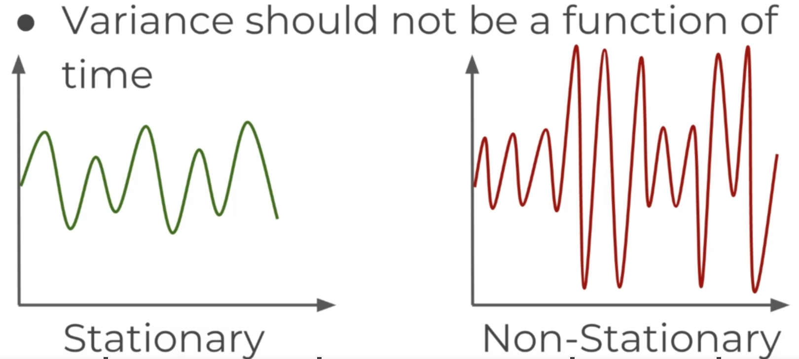
Stationary versus Non-Stationary Data
Stationary data has constant mean and variance over time
It will allow our model to predict that the mean and variance will be the same in the future time periods

Slide 28
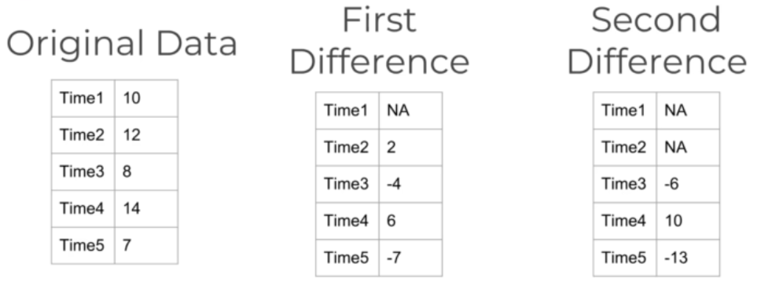
Is the Time Series Stationary Statistically?
Sometimes, visually we cannot make a precise guess
Here, we need to use the Augmented Dickey-Fuller Test (ADF) to check
If we conclude that the time series is not stationary, we may have to try differencing techniques to make it stationary
Example
Each differencing comes at the cost of losing a row of data
Continue doing this till we reach stationarity
-4 - (2) = -6
6 - (-4) = 10
-7 - (6) = -13

Slide 29
Differencing for Seasonal Data
For seasonal data, we can also difference by a season
Example: If we have monthly data with yearly seasonality, we could consider a time unit of 12, instead of 1

Slide 30
Choosing p, d, q
Once the data is stationary, we need to choose p, d, q – two methods
Use ACF and PCF plots – View them and observe the decay – Difficult
Grid search – Run ARIMA based on different combinations of p, d, q and compare the models for some evaluation metric – Easy but slower

